Slide 1
Intrusion detection system
i

Slide 2

Introduction
What is Intrusion detection system?
Datasets

Slide 3
Dataset
The dataset contains 5074413 combined of malcious and bengin with over 88 features for each, 20 of which are categorical. 12 DDoS attacks includes NTP, DNS, LDAP, MSSQL, NetBIOS, SNMP, SSDP, UDP, UDP-Lag, WebDDoS, SYN and TFTP on the training day and 7 attacks including PortScan, NetBIOS, LDAP, MSSQL, UDP, UDP-Lag and SYN in the testing day. The traffic volume for WebDDoS was so low and PortScan just has been executed in the testing day and will be unknown for evaluating the proposed modendertaken to inform baseline models and feature engineering.
Dataset Link: https://www.unb.ca/cic/datasets/ddos-2019.html

Slide 4
Problem
Malcious file
Detect if they Benign or Ddos

Slide 5
Imblanced data
Benign
DDos

Slide 6
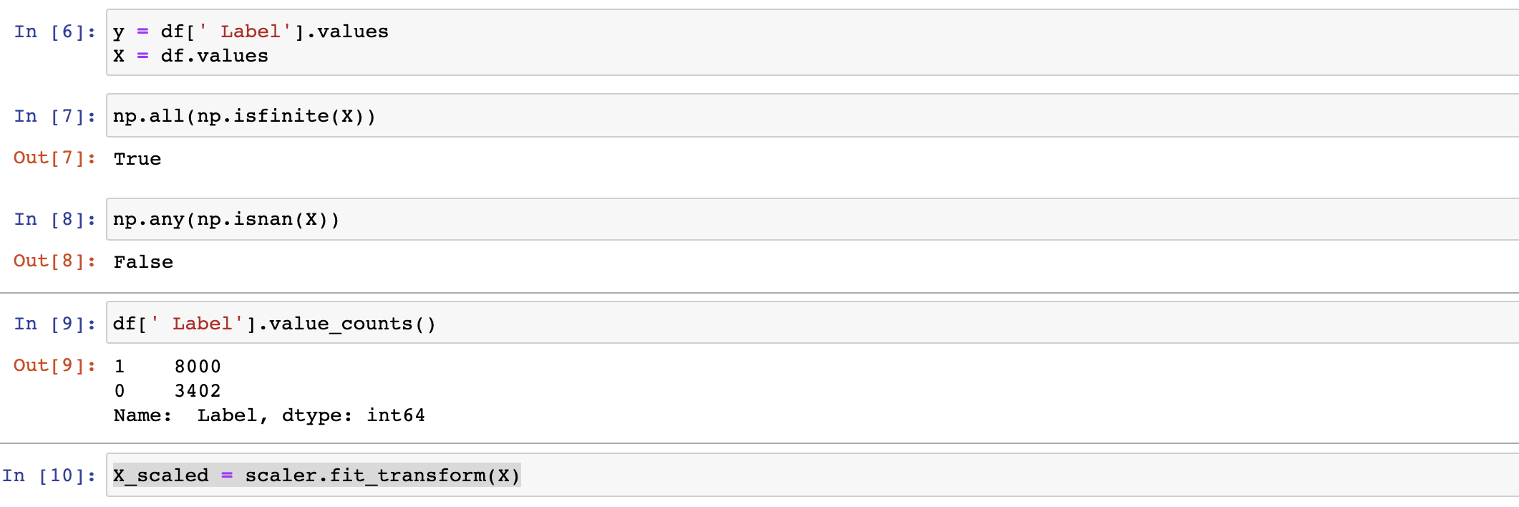
Scale

Slide 7
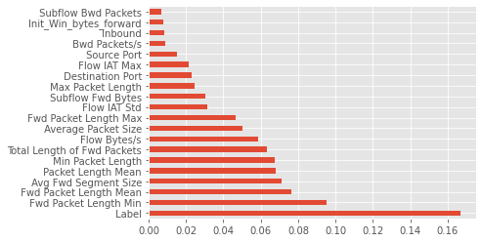
Feature importance
(pd.Series(model.feature_importances_, index=df.columns)
.nlargest(20)
.plot(kind='barh'))

Slide 8
Feature
Source Port
Protocol

Slide 9
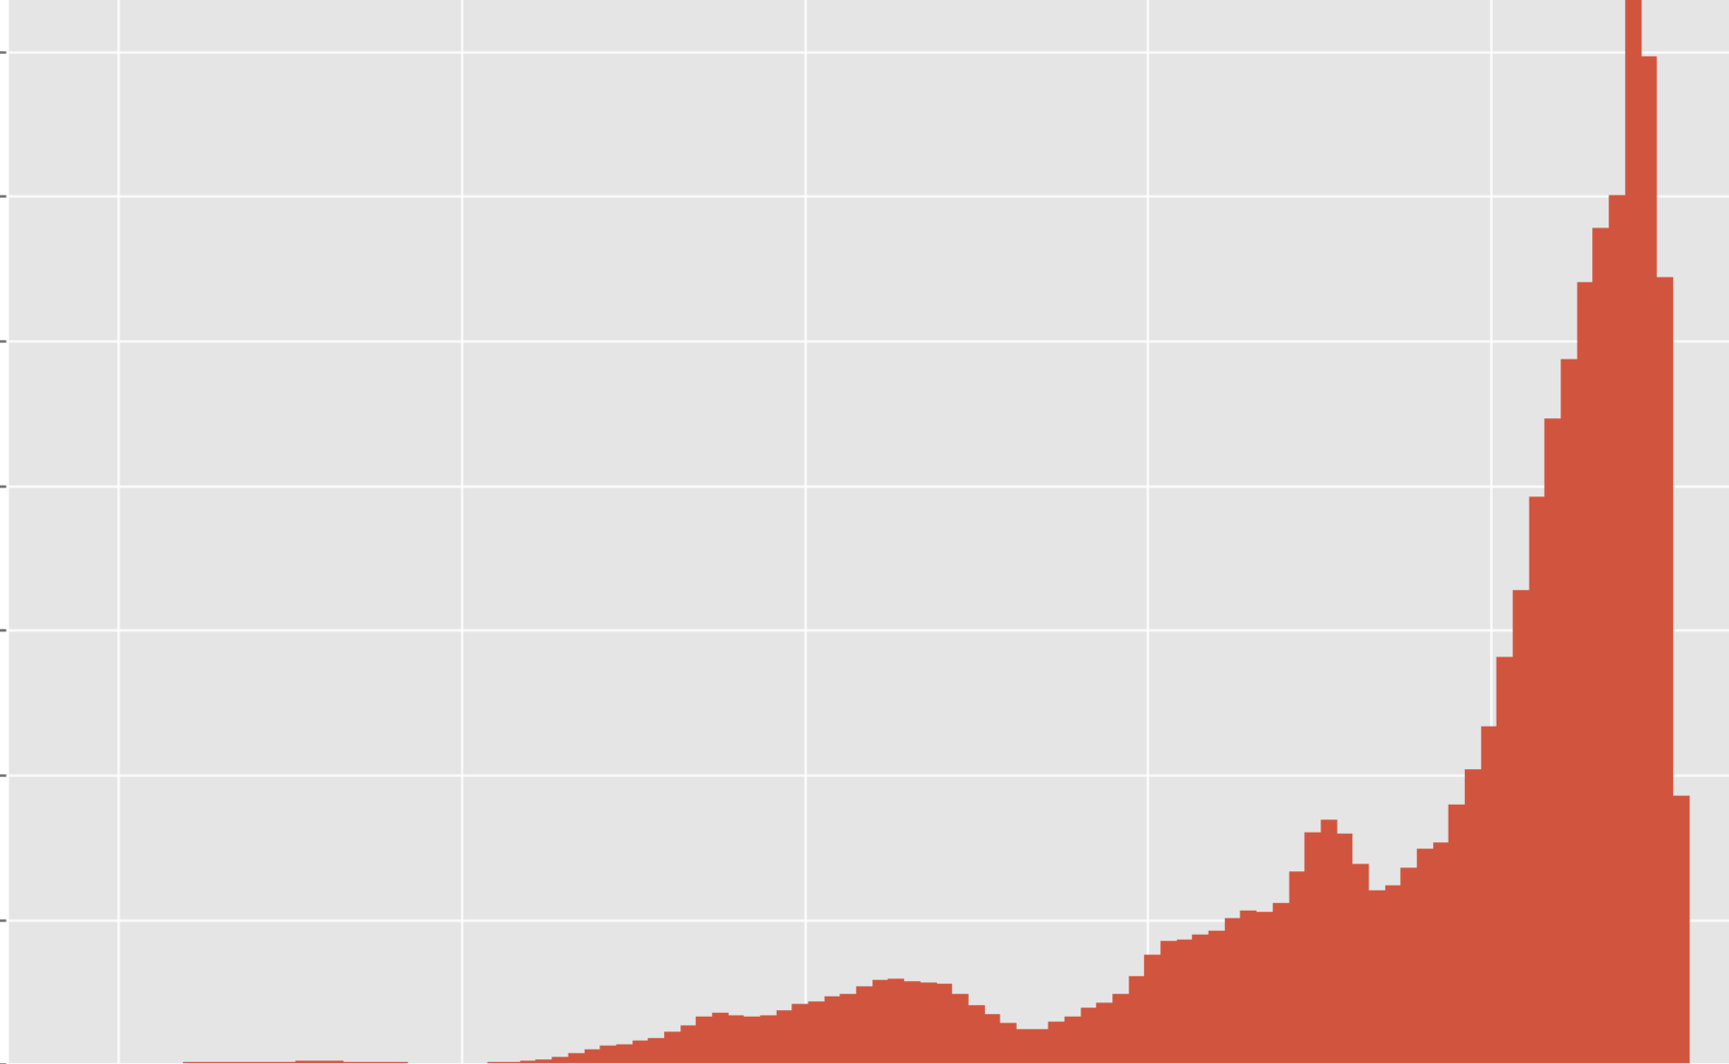
Benging vs DDos

Slide 10
The model
RNN
LSTM
Transformer

Slide 11
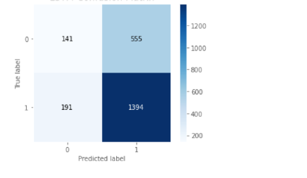
RNN
Accuracy: 67.30%

Slide 12
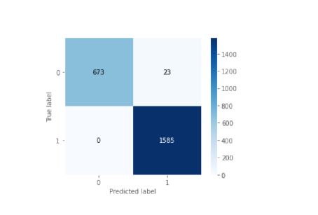
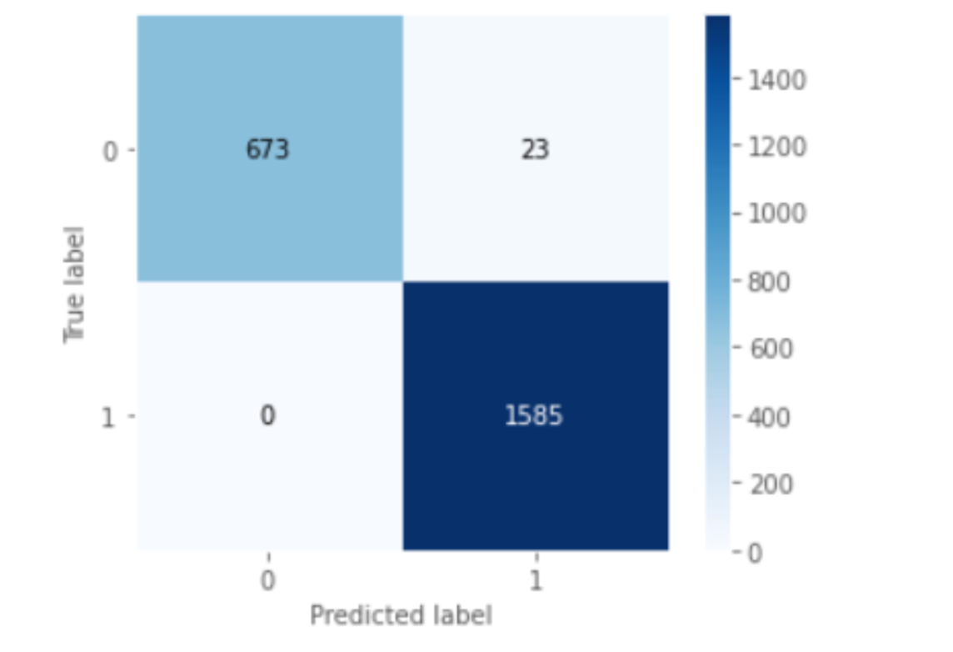
LSTM
Accuracy: 98.99%

